Slide 1

Process Mining Virtual Internship
by
M Shagufta Fathima
Roll No. 214G1A3299
Department of Computer Science and Engineering (Data Science)
Srinivasa Ramanujan Institute of Technology
(Affiliated to JNTUA & Approved by AICTE) (Accredited by NAAC with ‘A’ Grade & Accredited by NBA (EEE, ECE & CSE)
Rotarypuram Village, B K Samudram Mandal, Ananthapuramu – 515701.
2023 - 2024

Slide 2

Contents
Course Objective
Introduction
Technology
Applications
Modules
Real Time applications
Learning outcomes
GitHub Link
Queries

Slide 3
Course Objective
The course explains the key analysis techniques in process mining. Participants will learn various process discovery algorithms. These can be used to automatically learn process models from raw event data. Various other process analysis techniques that use event data will be presented.
Process mining applies data science to discover, validate and improve workflows. By combining data mining and process analytics, organizations can mine log data from their information systems to understand the performance of their processes, revealing bottlenecks and other areas of improvement.

Slide 4
Introduction
Process mining is a technique designed to discover, monitor, and improve real processes (i.e., not assumed processes) by extracting readily available knowledge from the event logs of information systems.
Process mining focuses on different perspectives, such as control-flow, organizational, case, and time. While much of the work around process mining focuses on the sequence of activities i.e., control-flow the other perspectives also provide valuable information for management teams.

Slide 5
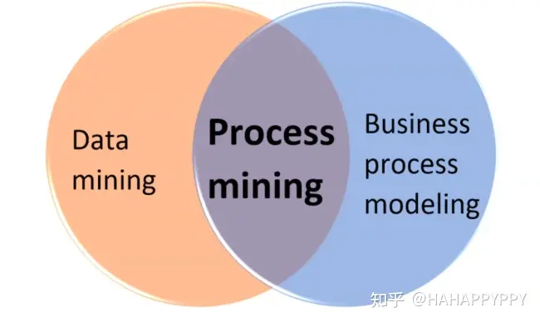
Intro…
Process Mining is the combination of two disciplines: Data Science and Business Process Management. Process Mining essentially uses Data Science techniques, such as Big Data and AI, to address Process Science problems such as process improvement and automation.
Process mining includes:
Automated process discovery
Conformance checking
Social network
Model extension
Model repair
Case prediction
History-based recommendations

Slide 6
Technologies
Process mining techniques benefit companies of any size and workflow. Process mining solutions can focus on various elements like the flow of a process, the organizational or time management with data mining and machine learning integration.
There are three main classes of process mining techniques:
Process Discovery
Conformance Check
Analysis and Enhancement

Slide 7
Applications
Applications of process mining involve using process mining techniques to analyze and improve processes as they occur, providing insights and interventions in real-time. Here are some examples of real-time applications of process mining:
Financial Services : Finance teams gather the information needed to gain a clear view of key performance indicators (KPIs). Examples include revenue generated, net income, payroll costs, etc. Data analytics allows finance teams to scrutinize and comprehend vital metrics, and detect fraud in revenue turnover.
Fraud Prevention: In financial transactions, real-time process mining can detect unusual patterns or behaviours that might indicate fraudulent activities. Immediate alerts can be triggered for further investigation.
Operational Monitoring and Alerts: Process mining can be used to monitor ongoing processes in real-time and generate alerts when deviations or anomalies are detected. This allows organizations to take immediate action to address issues and maintain process efficiency.

Slide 8
Applications
Emergency Response Management: During emergency situations or crisis events, real-time process mining can help organizations manage response processes effectively by identifying bottlenecks, allocating resources, and adapting to changing conditions.
Manufacturing Process Control: Real-time process mining can monitor manufacturing processes, identify deviations from optimal conditions, and trigger adjustments to maintain quality and efficiency.
Dynamic Resource Allocation: In scenarios where resources need to be allocated dynamically, such as in manufacturing or service industries, real-time process mining can help optimize resource allocation based on the current state of the process and demand.

Slide 9
Modules
Process Mining Fundamentals
Analysis Charts
Architecture of PQL
Joins and Filters
Data Integration

Slide 10
Process Mining Fundamentals
Process mining is an analytical discipline for discovering, monitoring, and improving processes as they are Process Mining works by extracting knowledge from event logs (also called digital footprints) readily available in today’s information systems, to visualize business processes and their every variation as they run.
Celonis Execution Management System (EMS) has to offer :
Process: A process is a series of linked steps taken to achieve a particular goal.
Activity: An activity is a step that occurs in the process. Process activities are actions that initiate or terminate a process or take place during it. Each activity consists of oneor more tasks that together are a milestone in the process.

Slide 11
Process Mining Fundamentals
Case: A case is an “item” or “object” you follow through the process. Even for the same business process, the case differs from company to company, depending on how granular they want to get.
Some organizations spend their resources trying to reconstruct the process only to see pieces of the entire picture, and only at a certain point in time. Others use the digital footprints from their transactional systems to get an objective, real-time perspective on their process. Congrats, your organization is of the latter type! When interacting with the dynamic visual representation and drilldown tools such as tables and charts, one can take an exploratory approach or a confirmatory approach.

Slide 12
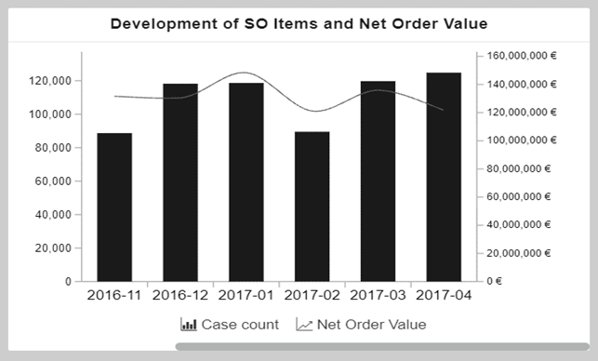
Analysis Charts
A dimension is a category of attributes; for example, the dimension "customer name" is a category for individual customer names.
Key Performance Indicators (KPIs) are used to
calculate and add aggregated values, for example,
case count, order value, invoice value, throughput
time, and automation rate.
In case you are a bit fuzzy on these concepts, do not worry, it'll get clearer as we look at dimensions and KPIs in a column chart and an OLAP table.

Slide 13
Analysis Charts
This chart shows the development of sales order items (KPI) and the corresponding net order value (KPI) over a period of time (dimension). The x-axis displays the dimension, the creation date of sales order, grouped by months.
The two y-axes display the KPIs: The columns display the number of sales order items (case count) and the line displays the net order value.This OLAP table is currently displaying three KPIs for all the sales organizations.
The first column displays the dimension, Sales Organization. The other three columns show KPIs: number of sales orders, average cycle time, and order value.

Slide 14
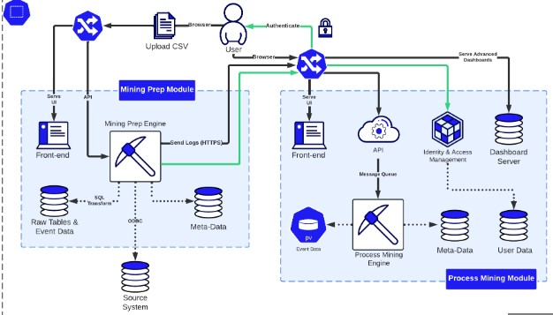
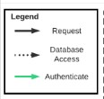
Architecture of PQL
Celonis PQL is an integral component of the Celonis Software Architecture. All Celonis applications use this language to query data from a data model.
Source System
Data Model
Data
Celonis PQL Engine
Applications
Metadata is data about the data or documentation about the information which is required by the users. In data warehousing, metadata is one of the essential aspects. Metadata is used for building, maintaining, managing, and using the data warehouses. Metadata allow users access to help understand the content and find data.

Slide 15
Joins and Filters
The tables in a Data Model are connected via specific relationships to associate rows of one table with rows of another table. This is done using a foreign key. In general, these relationships can be classified as:
One-to-many or 1:N
One-to-one or 1:1
Many-to-many or N:M
Depending on the number of rows of one table that can be matched with a row of another table. In Celonis Data Models only one-to-many (1:N) relationships are supported.

Slide 16
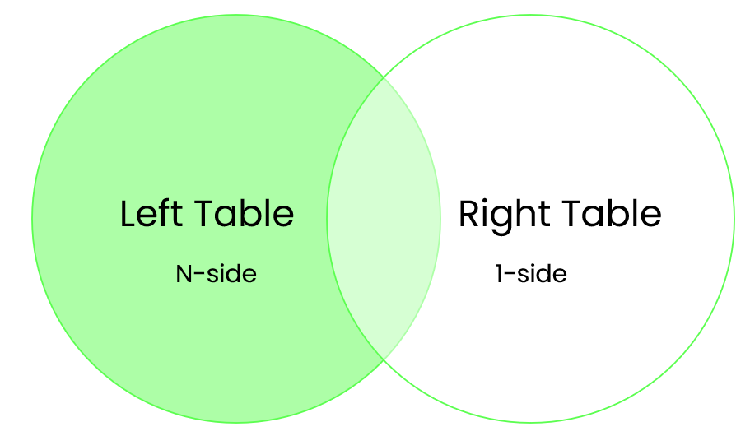
Joins and Filters
Every asset in Celonis has an underlying Data Model with multiple tables and 1:N relationships. The joins between those tables are left-outer joins, where the N-side is on the left.
Filters can be created on dashboards and used to modify the information displayed on all dashboards. With filters, you can create subsets of your data to have a closer look at particular parts of the process. Filters can be created from the header bar and the Filters panel.

Slide 17
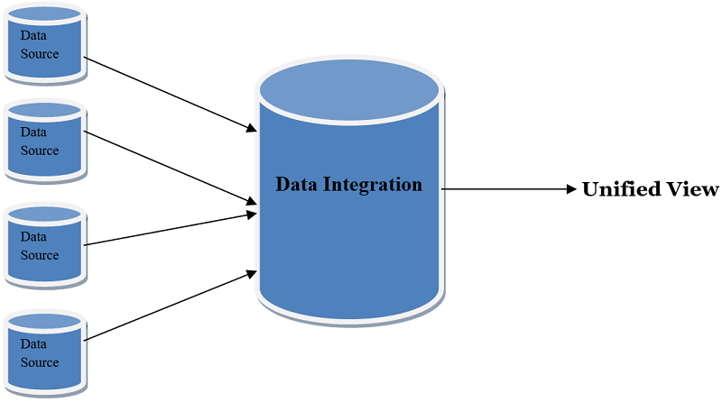
Data Integration
As a data engineer or analyst working in Data Integration (formerly known as Event Collection), you’re responsible for bringing in clean, real-time process data into the EMS. In other words, you build the data pipeline.
Process Data is a set of connected activities with timestamps following one specific case, or object. Every activity is an "event" and your task is to collect these events and organize them in the right order.

Slide 18
Data Integration
Get Data Into The EMS : It helps you connect to source systems, extract the relevant data, transform it to your needs, and load it into a polished Data Model. You can think of the Data Model as the fuel to all other work in your EMS. Once it’s ready, your team picks it up and can get started on analyzing it and acting on it.This process mainly involves 5 steps:
Process connect
Extract data
Transform data
Data Model
Execution Management System

Slide 19
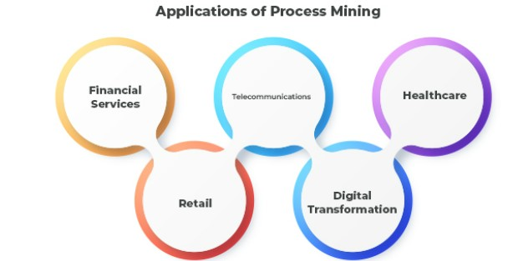
Real time Applications
Applications of process mining involve using process mining techniques to analyze and improve processes as they occur, providing insights and interventions in real-time. Here are some examples of real time applications of process mining:
Here are some applications:
Financial Services
Retail
Telecommunications
Digital Transformation
HealthCare

Slide 20
Learning Outcomes
Easily understandable about the process mining
Know about the analysis of charts
Understands how the architecture of PQL works
The way join operations are performed is understandable
know to get the data into EMS
It’s applications in real time

Slide 21
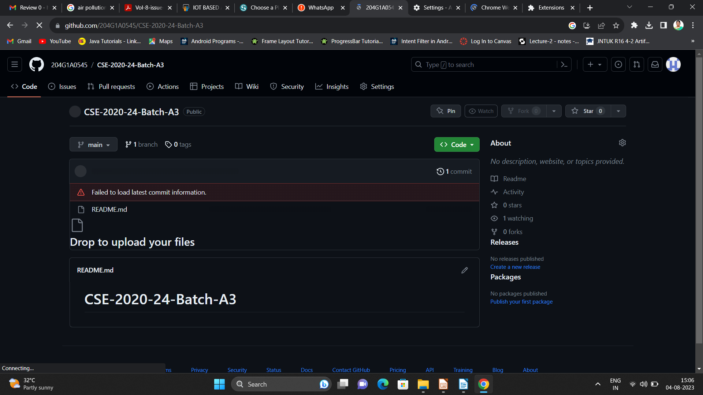

Git Hub Dashboard
Repository Name Like: Summer Internship - I
Under that include document, presentation and Certificate(Pdf).

Slide 22
Any Queries?

Slide 23
Thank You!!!

